Slide 1
COGS 138: Week 7 Section
February 16th, 2022

Slide 2
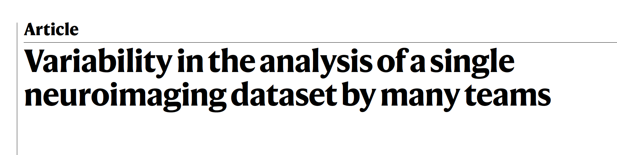
Questions about Reading #3? (due Friday)
Notes:
Quiz due this Friday

Slide 3
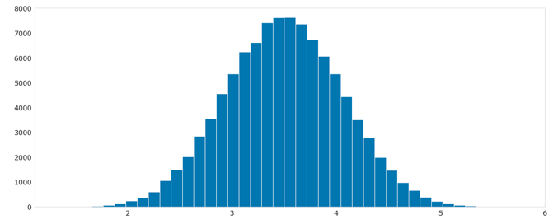

Central Limit Theorem Review
https://github.com/NeuralDataScience/Tutorials/blob/master/Central%20Limit%20Theorem.ipynb
Notes:
The central limit theorem states that if you have a population with mean μ and standard deviation σ and take sufficiently large random samples from the population with replacement, then the distribution of the sample means will be approximately normally distributed. This will hold true regardless of whether the source population is normal or skewed, provided the sample size is sufficiently large (usually n > 30). If the population is normal, then the theorem holds true even for samples smaller than 30.

Slide 4
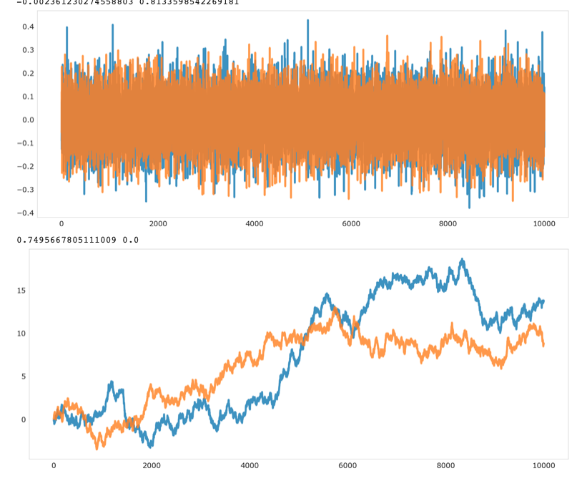
Correlation Resampling Review
https://github.com/NeuralDataScience/Tutorials/blob/master/Correlation%20resampling.ipynb
Notes:
I think the main take away from this notebook is the relationship between white noise to Brownian motion. That the np.cumsum of white noise == brownian motion, and the np.diff (or derivative) of brownian motion == white noise.
A second point is that any two independent white noise signals typically have a corrcoeff of ~0 but the corrcoeff of any two brownian motion signals will be evenly distributed between -1 and 1.
it's considered resampling because he's randomly sampling (bootstrapping) a Gaussian distribution to get the white noise signal

Slide 5
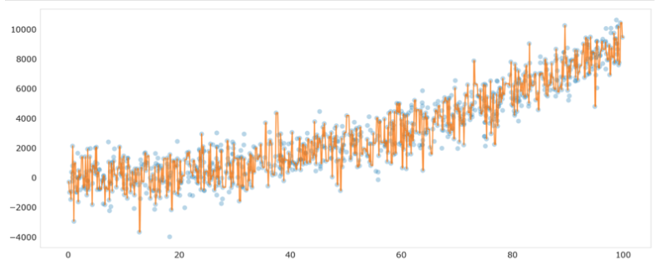
Overfitting Review
https://github.com/NeuralDataScience/Tutorials/blob/master/Overfitting.ipynb

Slide 6
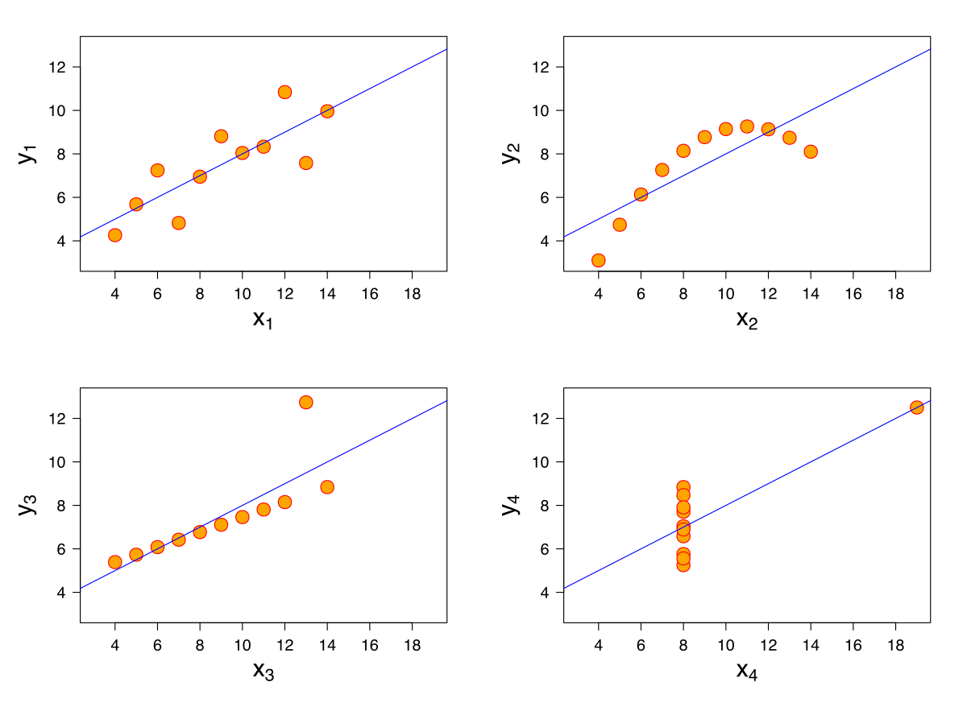
Brief Overview of A4 (released on datahub tomorrow)
Correlations
When should we vs. should we not use correlations in neuroscience research?
When is it possible to accidentally infer causality from correlation?
Tools you’ll be using:
Matplotlib (plotting library)
Seaborn (data viz library)
Scipy (stats library)
https://seaborn.pydata.org
https://matplotlib.org
https://scipy.org

Slide 7
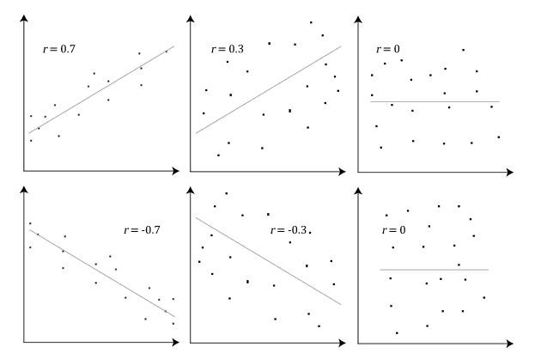
Brief Overview of A4 (released on datahub tomorrow)
Pearson vs. Spearman:
Pearson’s r
Linear correlation between two variables
Linear: A change in one variable is associated with a proportional change in the other variable
Values of +1 to -1
https://towardsdatascience.com/clearly-explained-pearson-v-s-spearman-correlation-coefficient-ada2f473b8
Notes:
https://towardsdatascience.com/clearly-explained-pearson-v-s-spearman-correlation-coefficient-ada2f473b8

Slide 8
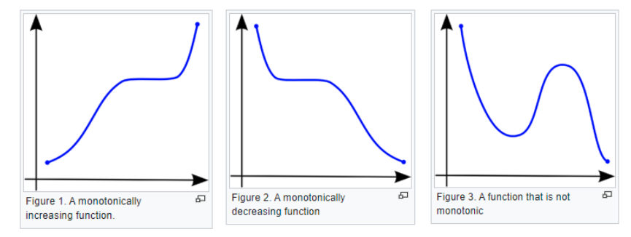
Brief Overview of A4 (released on datahub tomorrow)
Pearson vs. Spearman:
Spearman’s ρ (rho)
Nonparametric measure of rank correlation between two variables
How well the relationship between two variables is described by a monotonic function
Monotonic: as one value increases, the other consistently increases or decreases
https://towardsdatascience.com/clearly-explained-pearson-v-s-spearman-correlation-coefficient-ada2f473b8

Slide 9
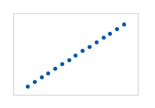
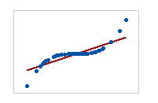
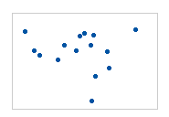
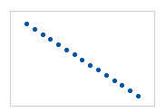
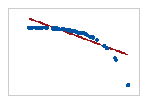
Brief Overview of A4 (released on datahub tomorrow)
Pearson: +1; Spearman: +1
Pearson: +0.851; Spearman: +1
Pearson: -0.093; Spearman: -0.093
Pearson: -1; Spearman: -1
Pearson: -0.799; Spearman: -1
https://towardsdatascience.com/clearly-explained-pearson-v-s-spearman-correlation-coefficient-ada2f473b8

Slide 10
General Announcements and Reminders
Reading Quiz due this Friday (2/18/22) at 11:59 PM (PST)
Three attempts
We will grade your last attempt, not your best attempt
A4 due next Friday (2/25/22) at 11:59 PM (PST)
Ask questions on slack!

